Slide 1
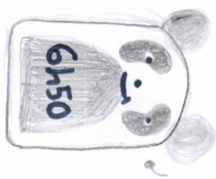
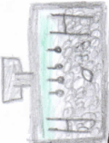
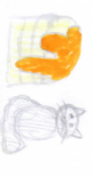
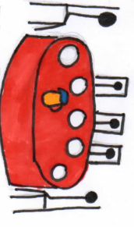
MY DAILY ROUTINE
At night I often play in my French rugby club. I sometimes watch TV.
I always wake up at 6:50 or I rarely wake up at 8:00.
I sometimes eat a chocolatine or I sometimes eat pancakes with my cat. He is so cut.
I often eat with my friends. We go to my friend‘s house.
I usually work in my house and I occasionally make board games and comic strips with Mathias.

