Slide 1
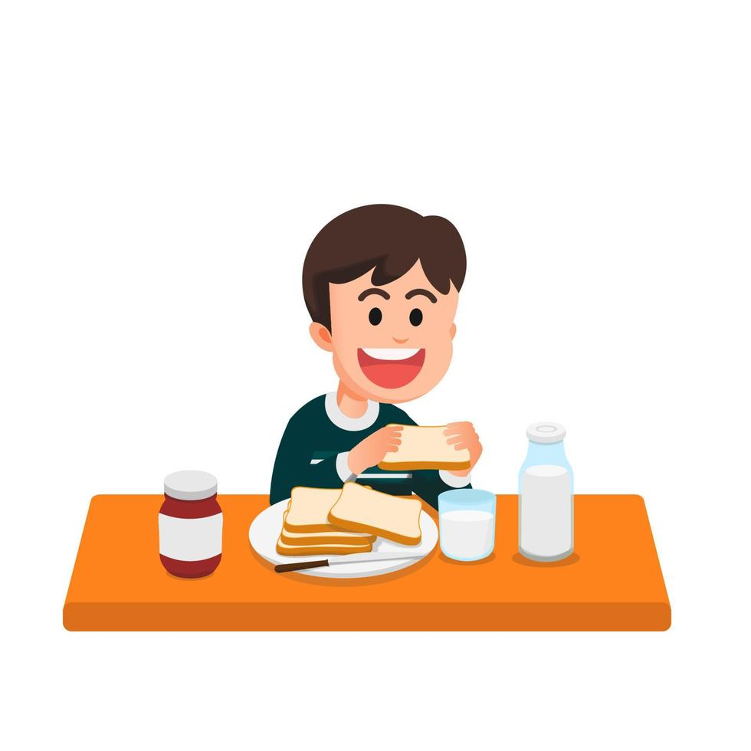
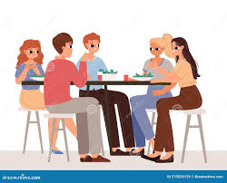
I always wake up at 7am and I often stay waiting at the side of my bed.
After I always dining and I always watch Tv and I finally go ti sleep at 10pm/ 11 pm but I never sleep at 8pm.
I usually eat my breakfast fast and I regulary go to school zt 7am/
My Daily Routine
I always work to 12h05 after I usually eat my lunch with my friends
When I am in my home I sometimes take my shower or I rarely go out with my friend

