Slide 1
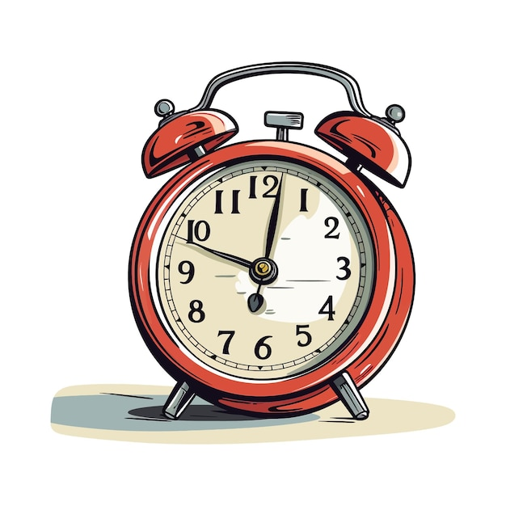
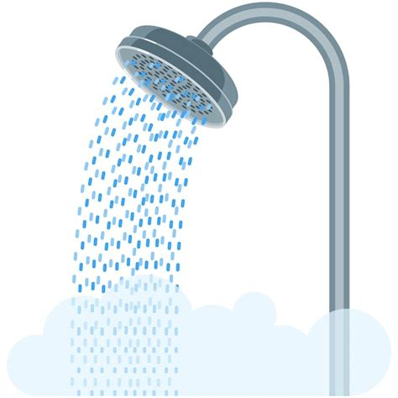
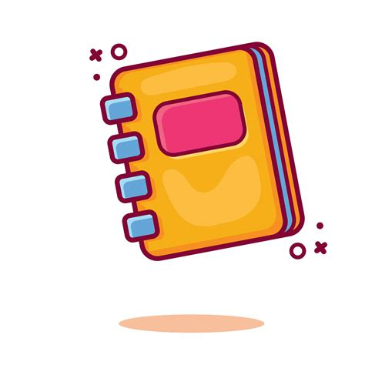
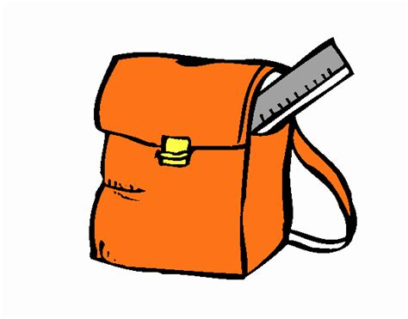
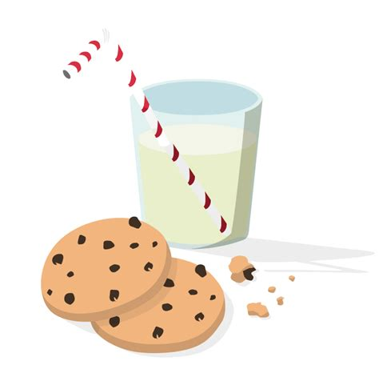
:
I always wake up at 6.55 am, I always dress up then I brush my hair.
Finally, I usually take my shower and I have dinner. I often go to bed at 10 pm
I always take my breakfast at 7.15 and after that I brush my teeth.
Diane’s routine
After school, I usually have a snack and I often do my homework.
I always prepare my backpack and I usually go to school at 7.55 am.

