Slide 1
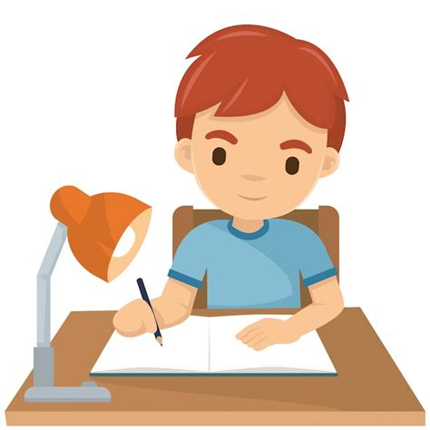
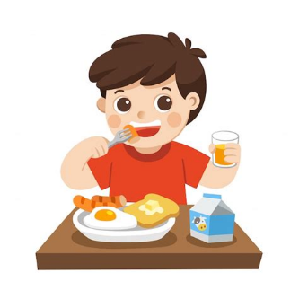
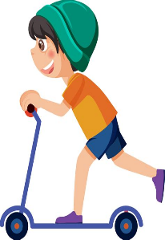
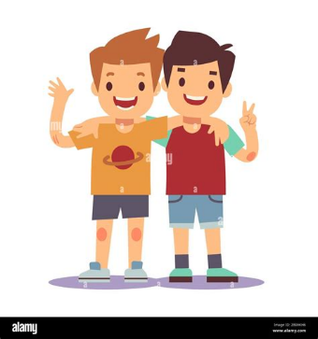
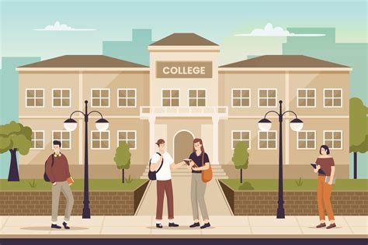
I wake up and
have
breakfast
I take my scooter
THEN I COME HOME FROM CLASS THEN I DO MY HOMEWORK
My daily routine
THEN I GO TO CLASS AND I WAIT FORT THE RING TO GO EAT
THEN I GO TO SCHOOL AND MEET MY FRIENDS

