Slide 1
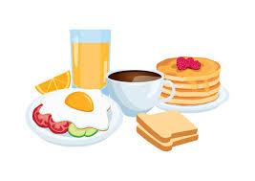
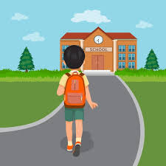
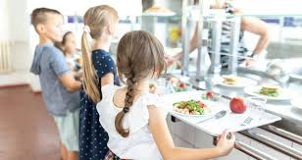
I rarely wake up at 7 am .I always eat a big breakfast.
I always walk to school and I sometimes meet my friends.
After scool I go to the karate and I often have a shower.
MY ROUTINE
At noon go to the canteen where I never eat the same things .
I never finish late .After I always do my homework.

