Slide 1
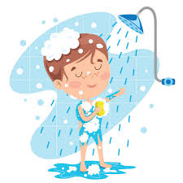
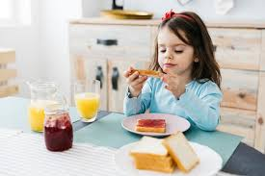
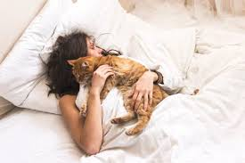
I always wake up at 7 am and I hug my cat.
I usually eat at 19:30
and I often take a shower
wake
I usually take my breakfast and I dress in my bedroom I sometimes brush my hair and my teeth and I often do my makeup.
My daily routine
I sometimes come back home at 16:40 and I take my snack and do my homework
I always go to school at 7:50 and I usually have lunch by 12:00 am

