Slide 1
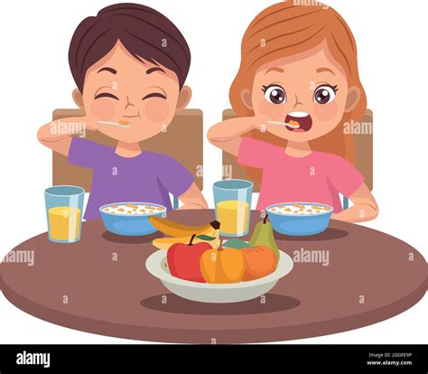
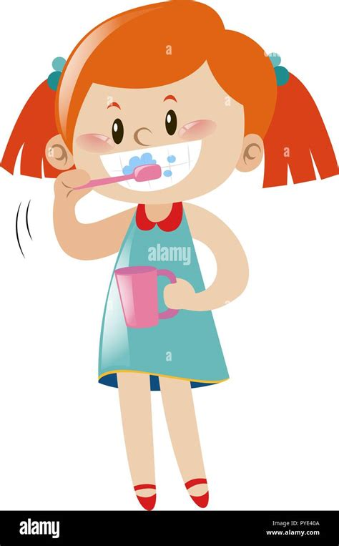
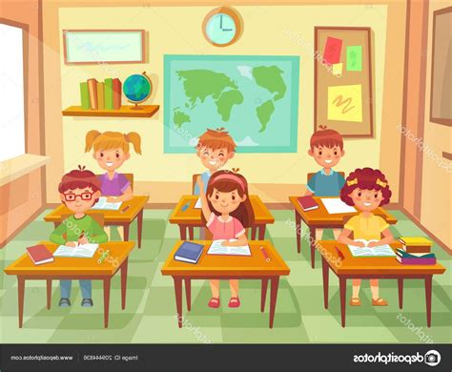
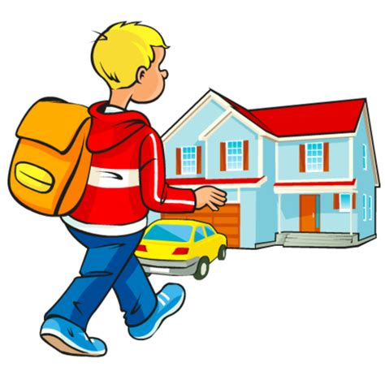
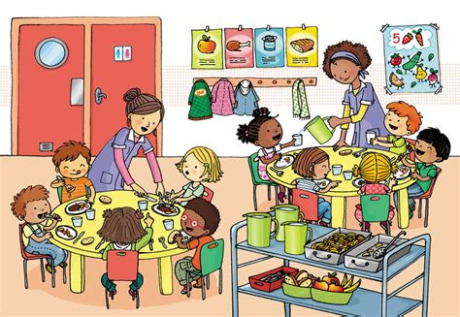
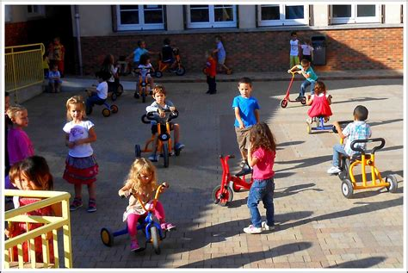
ss
I always wake up at 7 am every morning and i have breakfust
I usually get ready 15 minutes and always go to school
My routine
Then i always go home,i do my homework and i go to eat and i get ready to go to sleep
I’m often on time of class and i rarely eat something good in the cafetaria
We after the canteen we often take a little break at recess and then we always go to classe

