Slide 1
MY DREAM SCHOOL
DE LOU

Slide 2
THE NAME OF MY DREAM SCHOOL IS : COCO’S KNOWLEDGE

Slide 3
MY DREAM SCHOOL IS IN FRANCE

Slide 4
There are 800 students in my school and 100 classrooms

Slide 5
THE MATTERS OF MY SCHOOL AND MY DREAM SCHOOL TEACHERS :

Slide 6
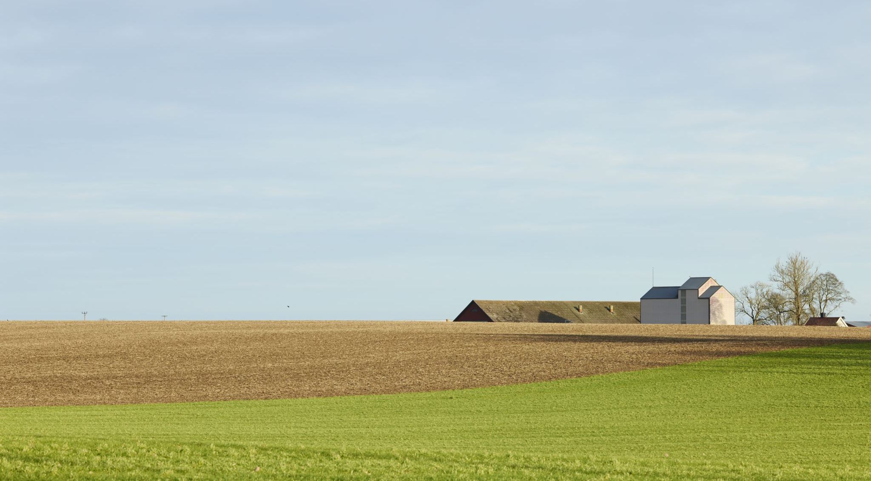
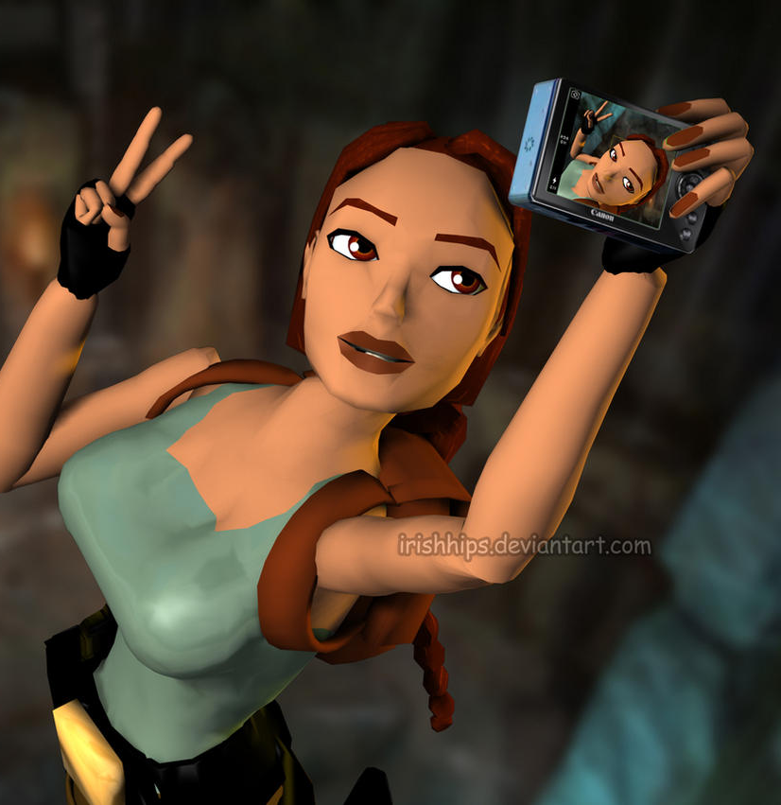
GEOGRAPHY
LARA CROFT

Slide 7
FRENCH:
EMMANUEL MACRON
Cette photo par Auteur inconnu est soumise à la licence CC BY-SA-NC

Slide 8
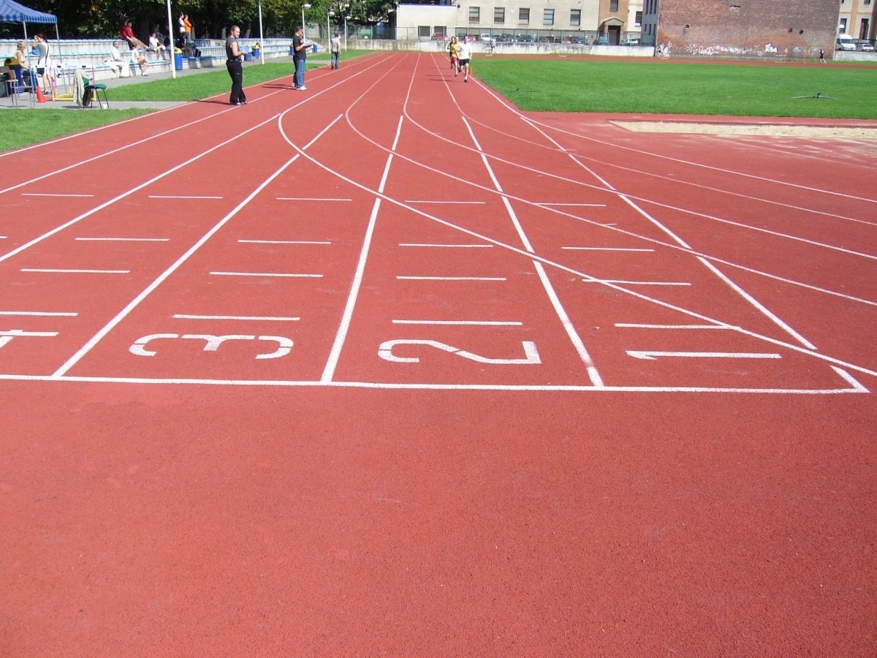
EP:
THE ROCK

Slide 9
SCIENCES :
ELON MUSK

Slide 10
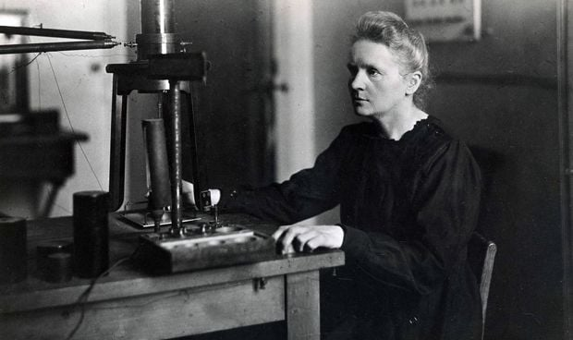
CHEMICAL PHYSICS :
MARIE CURIE

Slide 11
CLUBS OF MY SCHOOL :

Slide 12
MUSIC

Slide 13
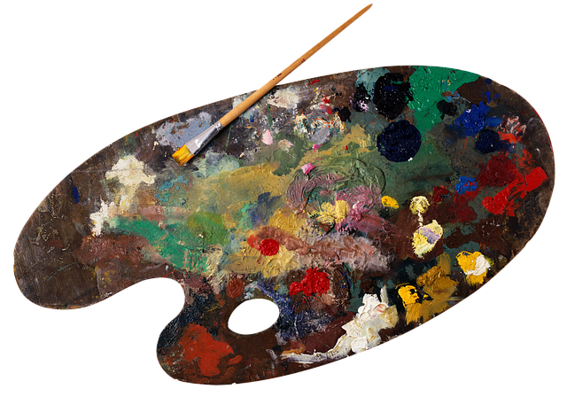
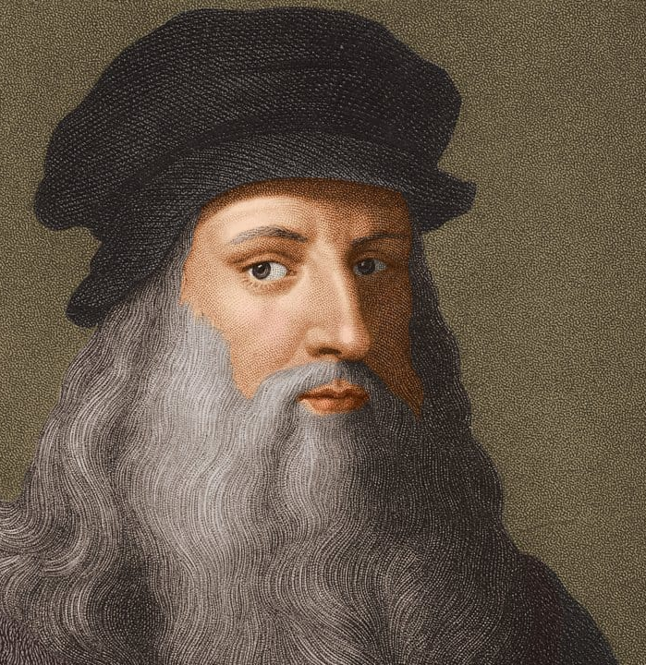
PLASTIC ART :
LEONARD DE VINCI

Slide 14
THE RULES OF MY SCHOOL

Slide 15
THERE ARE NOT UNIFORMS

Slide 16
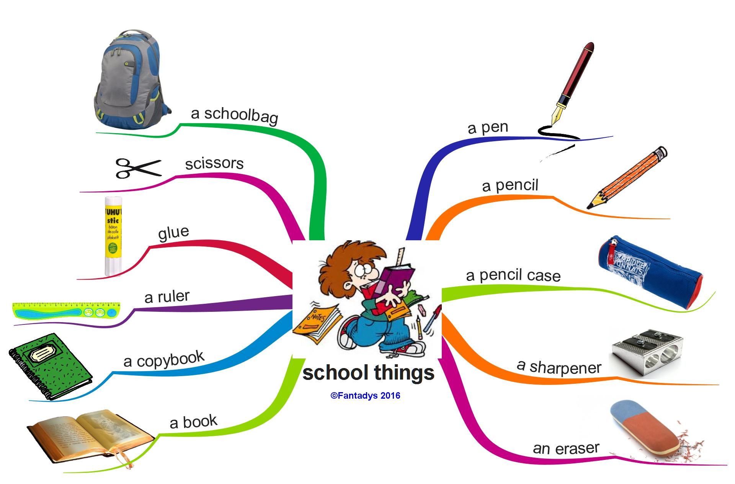
SCHOOL MATERIALS

Slide 17
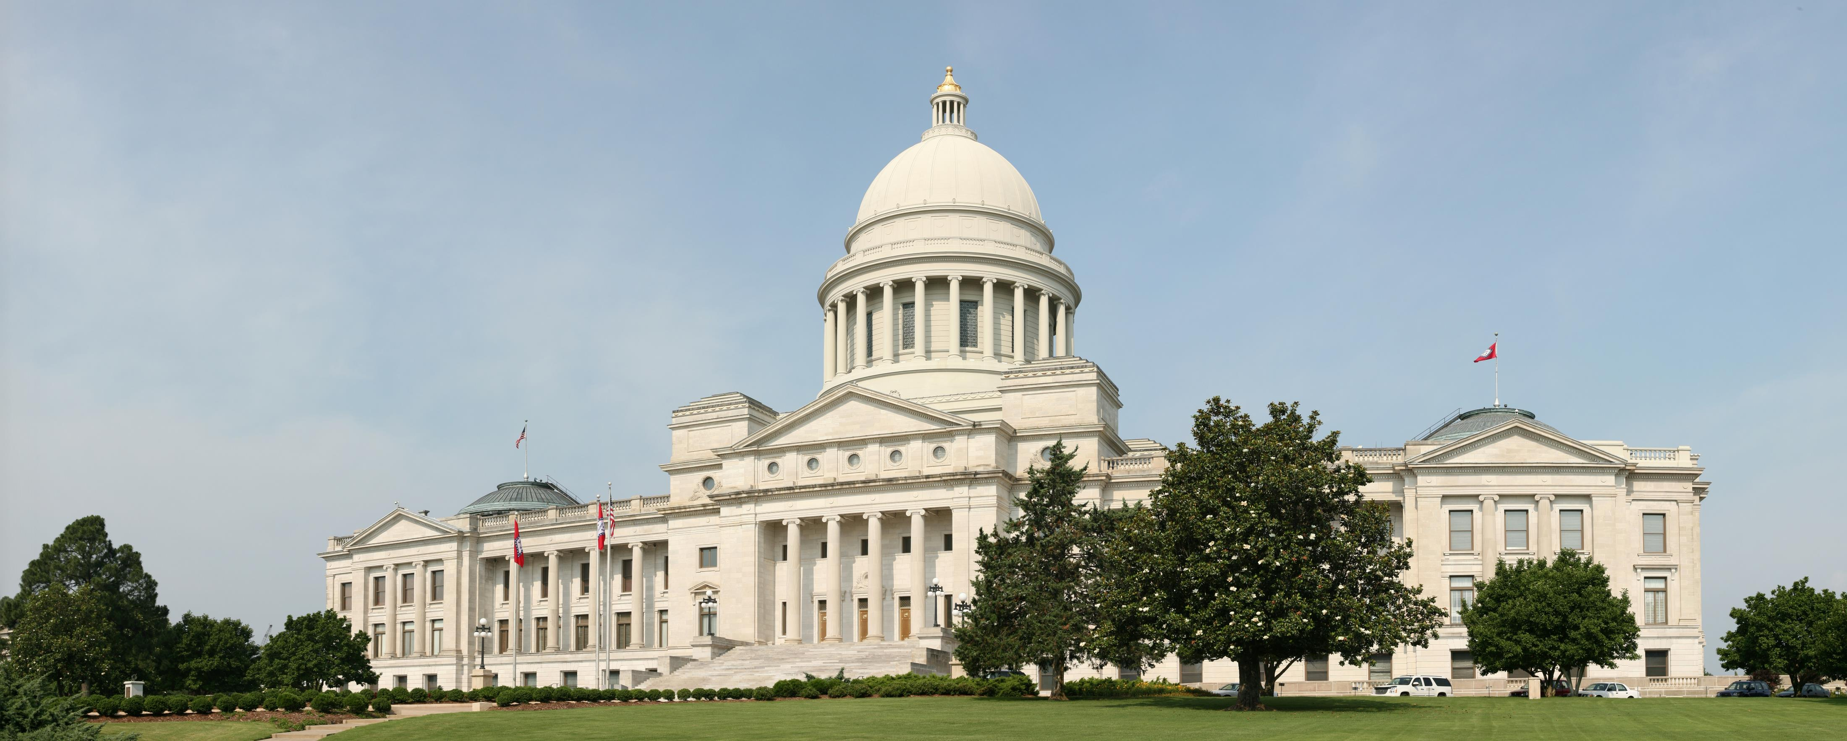
THE PLAN OF MY DREAM SCHOOL
CLASSROOMS
HALL

Slide 18
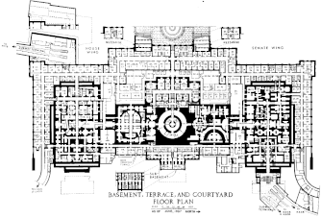
CANTEEN
CLASSROOMS
LIBRARY

Slide 19
THANK YOU FOR WATCHING

