Slide 1
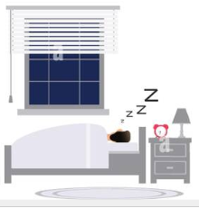
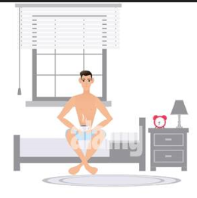
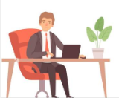
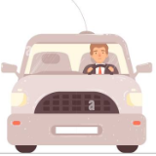
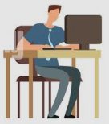
I usually wake up at 7 o’clock on the morning,then I always take my breakfast
At home I occasionally play with my brother and I always spend time with my parents until going to sleep
Milan
I always take my green scooter to go to school but I never take my parent’s car
After school I sometimes go to the skate park during 20 minutes with my friends, then I often do my homework until the dinner
During the lessons I am always at the front of the class and I rarely talk with my comrades

