Slide 1
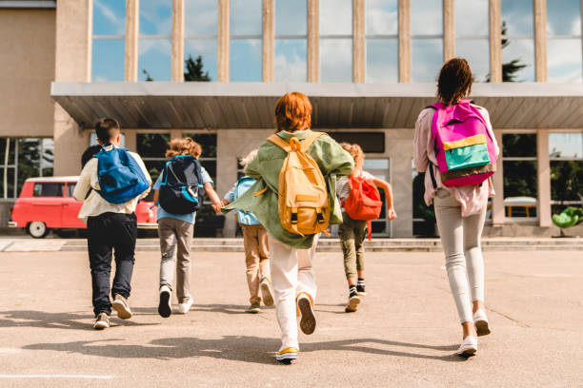
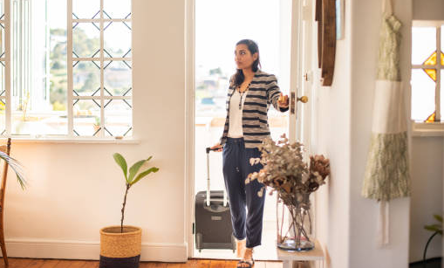
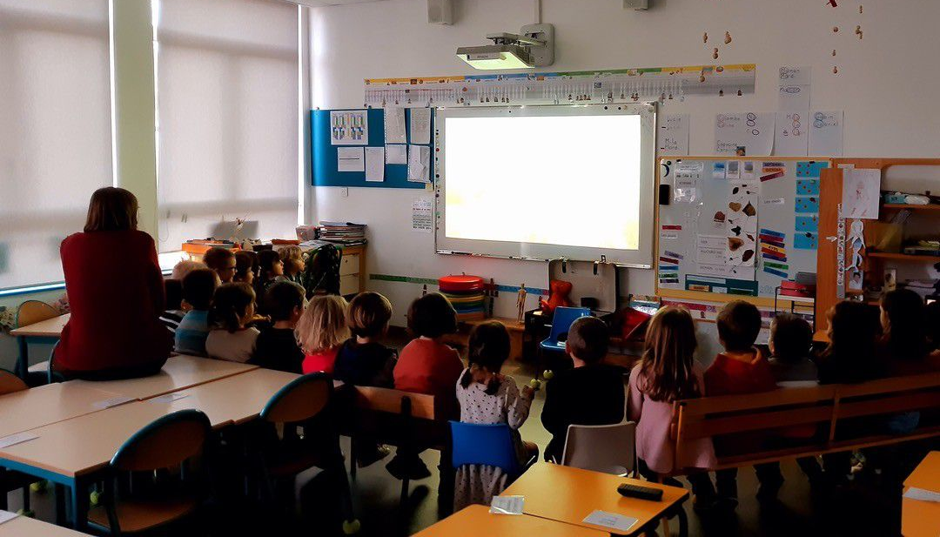
I always wake up at
7.00 am and I
sometimes eat toasts.
After the school, I often eat the dinner at 7.00 pm and I always sleep at 9.00 pm.
I always walk to school and I often meet my friends on the way.
MY ROUTINE
At school, I never finish late and I sometimes come home at 3.00 pm.
For lunch, I never come home and I usually have English cinema activity.

