Slide 1
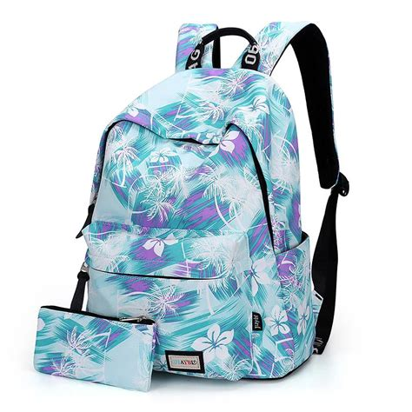
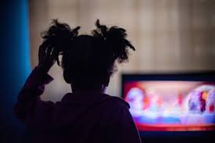
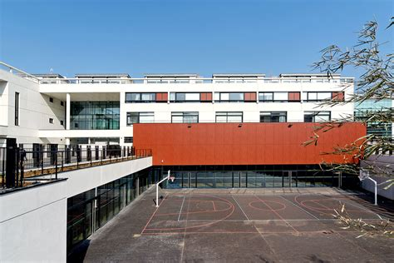
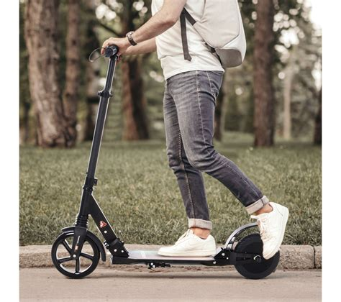
De Rebecca Kodja 6D
I wake up at 6.am ,I eat my breakfast and I usually brush my teeth
When I back at home I Thow my bacpack on the floor and I look the TV with my sister !!!!!!!!!!!!!!!!!!!!!!!!
I call my friends and we create a lot of ref
I do my bag go to school and I do my homework
MY
ROUTINE!!!!!!!!!!!!!!!!!!!!!!!!
At the end of the school I take my scoocer with my friend Narcisse and we leave school to go back at home
I go to school with Narcisse and sometimes with Dad

