Slide 1
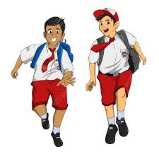
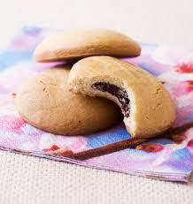
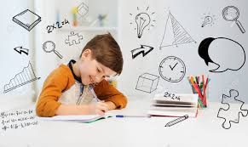
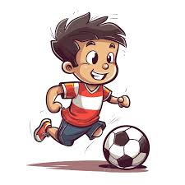
I always go to school with my friend. I never take the bus. I walk to school.
When I go to school, I always wake up at 7 and I take my breakfast : I always eat a bowl of cereals with a glass of orange juice
After school, at 4:30 pm, I always eat a small chocolate cake and drink a glass of milk.
My daily routine
Gabriel ROYER
During the week ends, I occasionally play football. I play in the garden. I rarely play chess with my sisters.
I often make my homework and after, I always play in my bedroom.
I always eat at 8:25 and then I go to bed at 9 pm.

