Slide 1
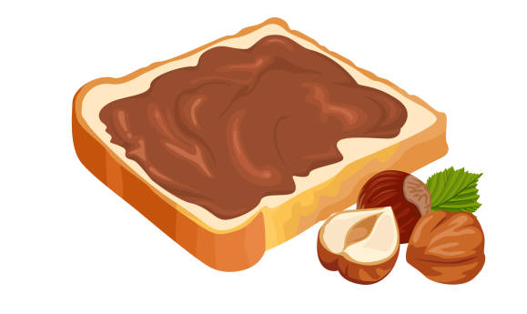
I usually wake up at 7 am and sometimes I get dressed before breakfast
After school, I always do my homework and
I have dinner before 9 pm
I always take my breakfast at 7.20 am and I often eat 2 toasts with nutella
Soline’s routine
Soline’s
Routine
Then I usually go to school at 7.50 am
I rarely walk without my friends
I always eat at the cafeteria.
But I never go to the library

